Slide 1

Group Project 2
Linxuan Guo, PiuSheung TANG, Yiqing Wen, Chenghao YANG, Yanqi Zhu

Slide 2

Introduction
IMDB stands for Internet Movie Database.
Which properties of films influence whether they are rated by IMDB as greater than 7 or not.
Used a generalised linear model(GLM) to fit the data.

Slide 3

Data processing
First omit those NA value.
Then, we use the column rating to create a binary factor.
And we omit the invalid column film_id and rating.
film_id | year | length | budget | votes | genre | rating
49834 | 1963 | 107 | 11.4 | 225 | Romance | 3.1
53923 | 1984 | NA | 9.7 | 59 | Comedy | 2.3
30020 | 1992 | 32 | 15.4 | 6 | Documentary | 7.7
46364 | 2000 | NA | 11.5 | 69 | Action | 2.3
19967 | 1964 | 87 | 9.4 | 34 | Comedy | 5.5

Slide 4

Data processing
The last column “greater_than_7” was added to each row to present whether the rating of the film is greater than 7.
 | year | length | budget | votes | genre | greater_than_7
1 | 1963 | 107 | 11.4 | 225 | Romance | IMDB rate less than 7
3 | 1992 | 32 | 15.4 | 6 | Documentary | IMDB rate greater than 7
5 | 1964 | 87 | 9.4 | 34 | Comedy | IMDB rate less than 7
6 | 2003 | 95 | 13.3 | 22 | Action | IMDB rate less than 7
7 | 1983 | 96 | 9.6 | 10 | Drama | IMDB rate less than 7

Slide 5

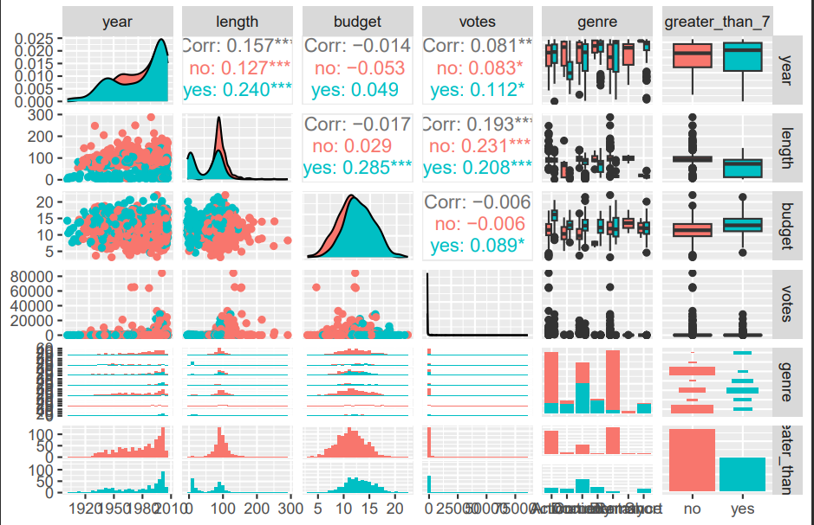
Exploratory Data Analysis
figure 1 shows that most correlations between explanatory variables are really insignificant.

Slide 6

Exploratory analysis
Figure 2 demonstrates the relationships between the four numerical variables and the response variable through multiple boxplots.
There are zero potential outliers in the top left corner plot.
There are many potential outliers in the top right corner plot.
There are eight potential outliers in the bottom left corner plot.
There are all potential outliers in the bottom right corner plot.

Slide 7
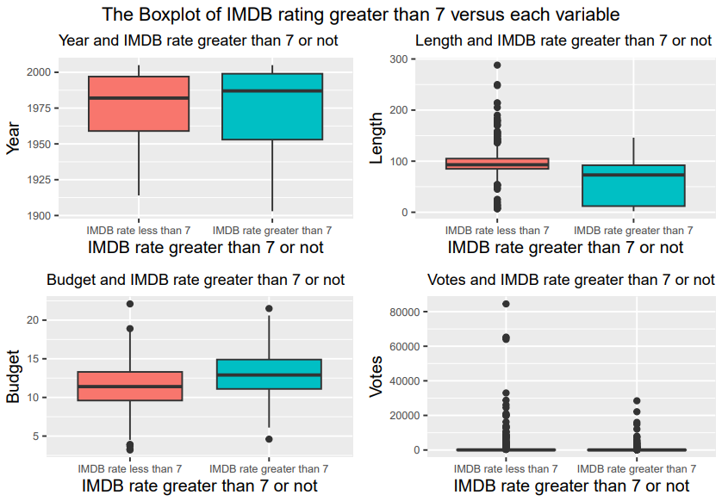
Exploratory analysis

Slide 8

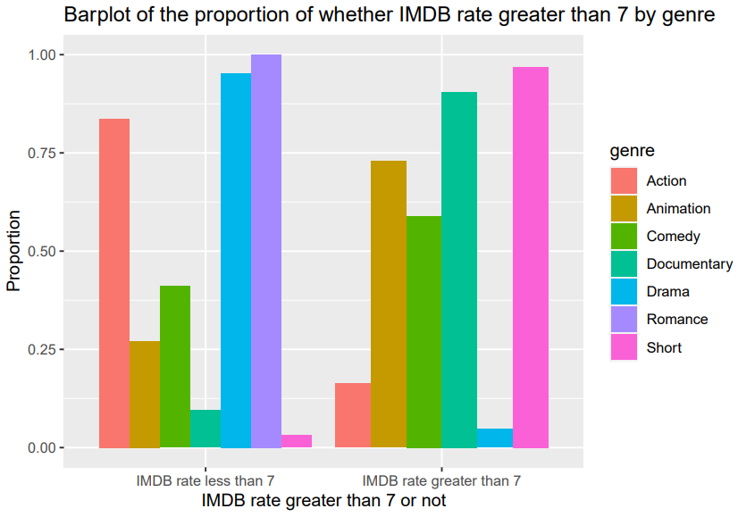
Exploratory analysis
The histogram shows how many IMDB rates are less than 7 and more than 7 in different movie genre, respectively.

Slide 9

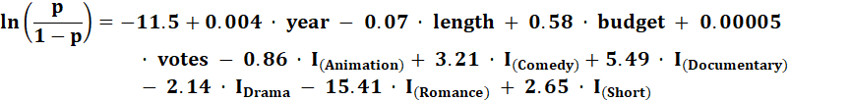
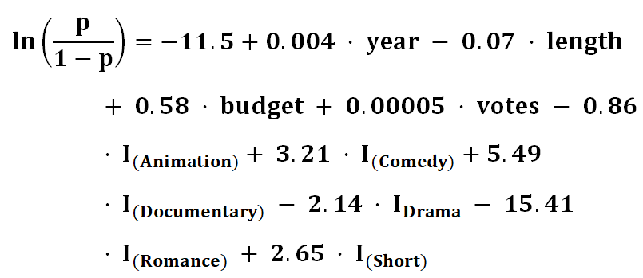
Modeling
Initial modelling

Slide 10

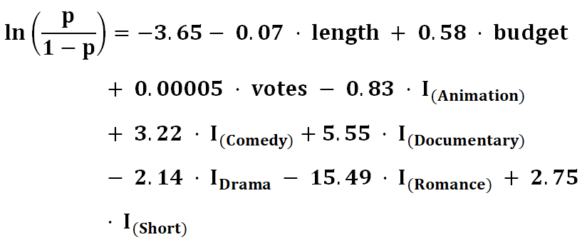
Model optimisation
Removed the value YEAR.

Slide 11

Conclusions
Assuming a probability greater than 0.5, the predicted outcome is classified as a rating greater than 7.
Prediction accuracy is 90%.
The factors that influence whether a film rating is greater than 7 are: length, budget, votes, and genre.

Slide 12

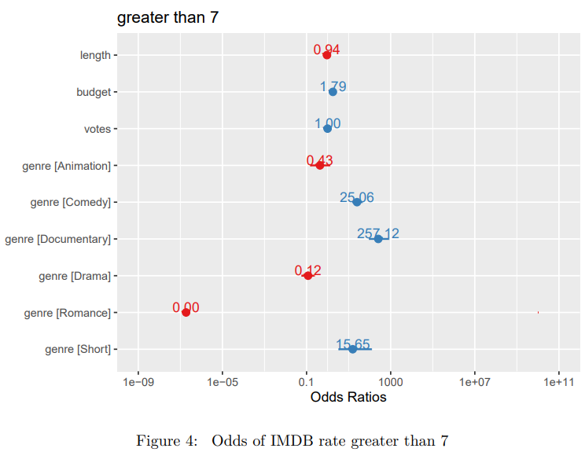
conculusions
figure 4 shows the odds ratios of each variable.
A red number indicates that the variable has a negative impact on the movie rating.
The variable corresponding to a blue number has a positive impact on the movie.

Slide 13



Thanks for listening.
#UofGWorldChangers
@UofGlasgow

